Slide 1
微软认知服务

Slide 2

1
微软人工智能服务和API概览
2
视觉API
3
语音及语义API

Slide 3











Slide 4

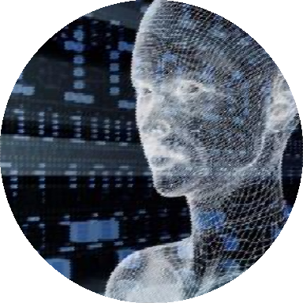
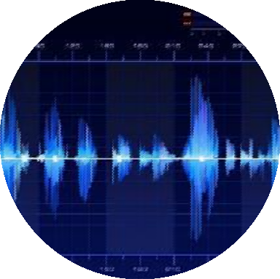

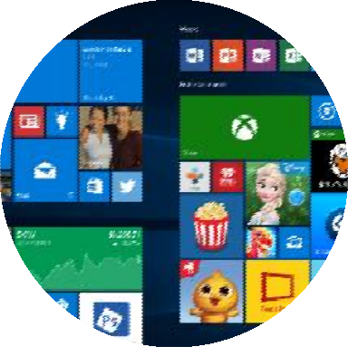





Slide 5



大数据 & 机器学习
认知计算能力
对话即服务的体验

Slide 6


















微软AI 基础架构和服务

Slide 7

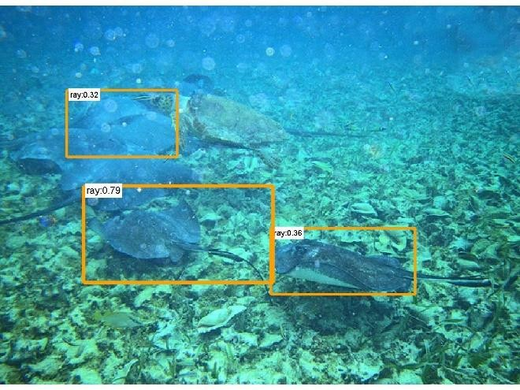

ImageNet Classification top-5 error (%)
Fish or stone???
28.2
25.8
8 layers
16.4
8 layers
11.7
19 layers
22 layers
7.3
6.7
5.1
152 layers
3.5
ILSVRC 2010
NEC America
ILSVRC 2011
Xerox
ILSVRC 2012
AlexNet
ILSVRC 2013
Clarifi
ILSVRC 2014 VGG
ILSVRC 2014
GoogleNet
Human Performance
ILSVRC 2015
ResNet

Slide 8













微软
认知服务
利用世界领先的人工智能技术，
让您的应用更具人性化

Slide 9





























微软认知服务API 一览
微软
认知服务
利用世界领先的人工智能技术，
让您的应用更具人性化

Slide 10


人脸识别 API
人脸检测
检测图片中的人脸并识别属性
人脸验证
核对两张人脸是否属于同一个人
相似人脸搜索
从多张人脸中找出与所查人脸相似的人脸
人脸分组
根据识别的人脸进行分组
人脸辨识
查询某张人脸，与提供的数据中的何人相匹配

Slide 11

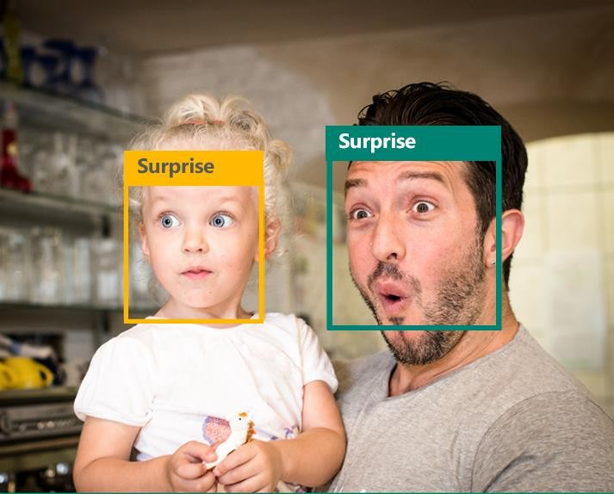
情感识别 API
人脸检测
"faceRectangle": {"width": 193, "height": 193, "left": 326, "top": 204}
…
情感指数
“scores": { "anger": 5.182241e-8, "contempt": 0.0000242813, "disgust": 5.621025e-7, "fear": 0.00115027453,
"happiness": 1.06114619e-8, "neutral": 0.003540177, "sadness": 9.30888746e-7, "surprise": 0.9952837}

Slide 12


语音API
语音识别 (语音转文本)
将语音转换为文本
语音输出(文本转语音)
将文本合成语音
声纹识别

Slide 13





语言理解智能服务
用交互的特征来减少贴标签的工作 使用可视化来测量和提升性能
与语音识别服务的无缝集成
几个样例就足以搭建自己的应用，并自主学习

Slide 14





















Slide 15


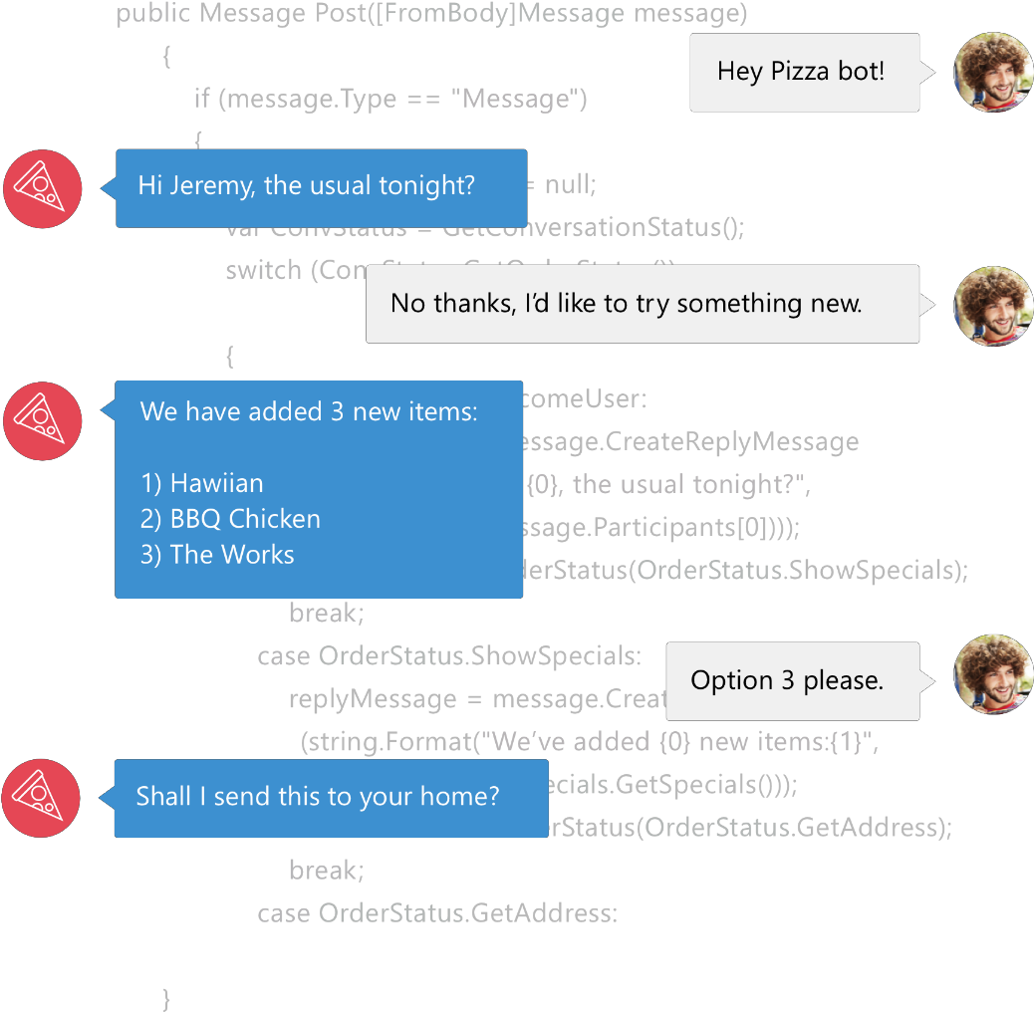

Bot 框架是一个 Microsoft-operated 服务
也是一个 SDK.
Bot 框架是微软提供编写bot机器人的众多 技术之一
其他技术: LUIS(语义理解), Speech APIs(语音识 别技术), Azure, more

Slide 16



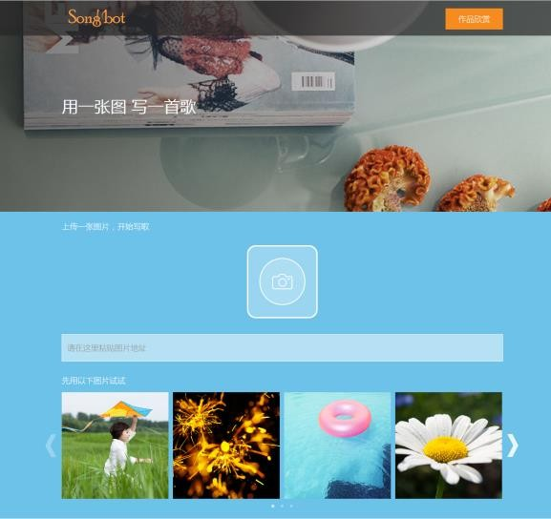

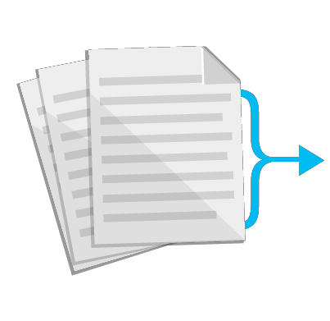











Description
{ "type": 0, "captions": [ { "text": "a large pool of water", "confidence": 0.9238396259641459 } ] }
Tags
[ { "name": "water", "confidence": 0.9946225881576538 }, { "name": "floating", "confidence": 0.5980461239814758 }, { "name": "pink", "confidence": 0.566018283367157, "hint": "flower" }, { "name": "pool", "confidence": 0.5110839009284973 }, { "name": "swimming", "confidence": 0.4737638235092163, "hint": "sport" }, { "name": "reef", "confidence": 0.35733458399772644 }, { "name": "ocean floor", "confidence": 0.02047446183860302 } ]
[ { "name": "person", "confidence": 0.9994096755981445 }, { "name": "indoor", "confidence": 0.9689207673072815 }, { "name": "wall", "confidence": 0.9660900235176086 }, { "name": "music", "confidence": 0.8815137147903442 }, { "name": "piano", "confidence": 0.6432550549507141, "hint": "object"
} ]
"age": 23.7,
"gender": "female",
"happiness": 0.999918044,

Slide 17
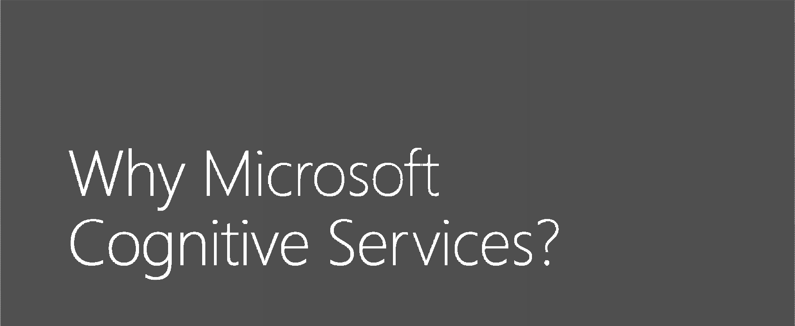









Easy
Flexible
Tested
简单地使用REST APIs 就可使用
很少的代码量，即可在应用中增加智 能场景
你可以使用你熟悉的开发语言，同时轻 松跨越各种平台
灵活地通过不同的API使用不同的服务
和技术，多种服务也可方便地混合使用
由来自微软Microsoft Research, Bing, 和Azure Machine Learning各领域里 的专家精心打造
高质量的文档，示例代码，和社区的
支持
GET A
KEY

Slide 18





Slide 19
本节课程内容概述
课程标题
01 | 视觉API详解

Slide 20


Vision
Computer Vision API
Distill actionable information from images
Face API
Detect, identify, analyze, organize, and tag faces in photos
Emotion API
Personalize experiences with emotion recognition
Video API
Analyze, edit, and process videos within your app
Content Moderator
Automated image, text, and video moderation

Slide 21





200K celebrities from business, politics, sports and entertainment around the World.

Slide 22



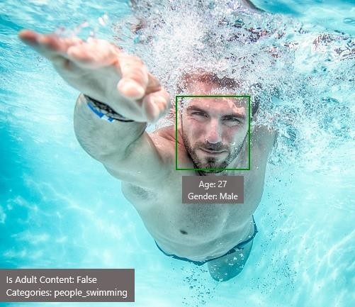










Slide 23




Slide 24
JSON:
{
"language": "en",
"orientation": "Up",
"regions": [
{
"boundingBox": "41,77,918,440", "lines": [
{
"boundingBox": "41,77,723,89",
"words": [
{
"boundingBox": "41,102,225,64", "text": "LIFE"
},
{
"boundingBox": "356,89,94,62",
"text": "IS"
},
{
"boundingBox": "539,77,225,64", "text": "LIKE"
}
. . .

Slide 25



Slide 26







Slide 27





Slide 28

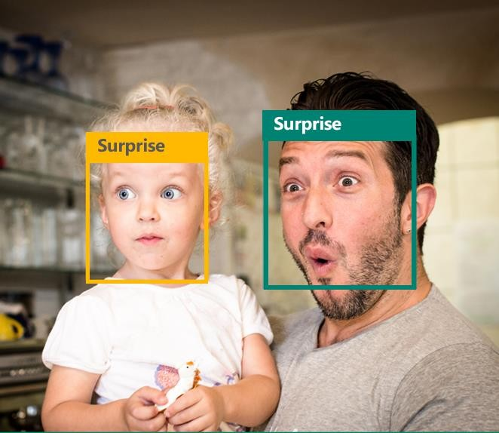


"faceRectangle": {"width": 193,
"height": 193,
"left": 326,
"top": 204}
“scores": { "anger": 5.182241e-8,
"contempt": 0.0000242813, "disgust": 5.621025e-7, "fear": 0.00115027453,
"happiness": 1.06114619e-8, "neutral": 0.003540177, "sadness": 9.30888746e-7, "surprise": 0.9952837}

Slide 29







Slide 30








"faceRectangle": {"width": 193, "height": 193, "left": 326, "top": 204}
…
"attributes": { "age": 42, "gender": "male",
"headPose": { "roll": "8.2", "yaw": "-37.8", "pitch": "0.0" }}

Slide 31
Developer Resources
Pricing
https://www.azure.cn/pricing/details/cognitive-services/
Documentation
https://www.azure.cn/documentation/services/cognitive-services/
Client SDKs
https://github.com/Microsoft/ProjectOxford-ClientSDK https://github.com/felixrieseberg/project-oxford (nodejs) https://github.com/southwood/project-oxford-python
Example Code
https://github.com/Microsoft/Cognitive-Samples-IntelligentKiosk/
https://github.com/Microsoft/Cognitive-Samples-VideoFrameAnalysis/
Community
https://stackoverflow.com/questions/tagged/microsoft-cognitive https://social.msdn.microsoft.com/forums/azure/en-US/home?forum=mlapi https://cognitive.uservoice.com/

Slide 32




Slide 33
本节课程内容概述
课程标题
01 |自然语言理解详解（LUIS）
02 | 认知服务- Language(语言) API
03 | 认知服务- Speech(语音) API

Slide 34

自然语言理解详解（LUIS）

Slide 35
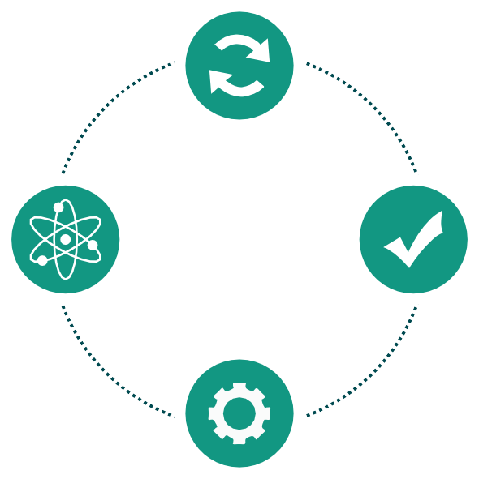
A Microsoft Cognitive Service that provides developers with an easy way to create language models to allow applications to understand user commands.
Introducing Language Understanding Intelligence Service (LUIS)
Train by providing examples
Deploy to an HTTP endpoint and activate on any device
Create your own LU model
Maintain model
with ease

Slide 36

LUIS Common Usage Scenarios
IoT experiences
LUIS has been used to build a wide range of IoT applications ranging from a simple voice activated lights control to smart kitchen appliances, smart vending machines, facial recognition door, and many more
Chat bots
LUIS offers integration with Microsoft Bot Framework and Slack, which enables developers to build and connect intelligent bots to interact with users no matter which device they are on or which technology they are using
Virtual assistance
LUIS uses pre-built models from Bing and Cortana which enable developers to easily add personal assistant functionalities to their apps.

Slide 37

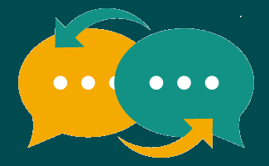


LUIS Benefits
Easy:
Use simple UX editor to create language understanding models
Fast:
Add conversational intelligence to your apps in minutes
Flexible:
Activate models on any device
Expert:
Leverages MSR technology
Create models for your application to better understand intents like "turn on the lights", or entities such as "start a new jog/walk/hike/bikeride". Tune your model with in-depth performance visualizations.
LUIS has a powerful dialog engine that enables you to maintain context, author and execute any dialog in just a few steps.
Activate your language understanding models from your application on your phone, tablet, or any other device that has access to the Internet.
LUIS leverages innovative AI
technology from Microsoft Research.

Slide 38

认知服务- Language(语言 ) API

Slide 39
























Cognitive services
Language
Text analytics
Bing spell check
Web language model
Linguistic analysis
Language understanding
Translator

Slide 40
Translator API
Add speech translation, for any of the 9 supported languages, and text translation, for any of the 60 supported languages, to your app. Grow your potential user base by localizing your app and its content with clear translations
Build a custom translation system, using as little as 1,000 parallel sentences or start out simply by providing a dictionary of company specific words.

Slide 41

认知服务- Speech(语音) API

Slide 42

Cognitive services
Speech
Language
Speaker recognition
Text analytics
Speech
Bing spell check
Custom recognition
Web language model
Linguistic analysis
Language understanding
Translator

Slide 43

Bing Speech API, a cloud-based API that provides advanced algorithms to process spoken language. With Bing Speech API you can add speech driven actions to your apps, including real-time interaction with the user.
Bing Speech API has two components:
Speech To Text API: For apps converting spoken words to text.
Text To Speech API: For apps converting text into audio that can be played back to the user.
Bing Speech APIs and libraries enables speech capabilities on all internet- connected devices. Every major platform including Android, iOS, Windows, and 3rd party IoT devices are supported. It offers industry-leading speech-to-text, text-to-speech, and language understanding capabilities delivered through the cloud.
Microsoft uses Bing Speech API for Windows applications like Cortana and Skype Translator as well as Android applications like Bing Torque for Android Wear and Android Phone.

Slide 44

Custom Speech Service is a cloud-based service that provides users with the ability to customize speech models for Speech-to-Text transcription. To use the Custom Speech Service refer to the Custom Speech Service Portal
Speech recognition systems are composed of several components that work together. Two of the most important components are the acoustic model and the language model.
For example, if you were building an app to search MSDN by voice, it’s likely that terms like “object-oriented” or “namespace” or “dot net” will appear more frequently than in typical voice applications. Customizing the language model will enable the system to learn this
For more: https://docs.microsoft.com/zh-cn/azure/cognitive- services/Custom-Speech-Service/Home

Slide 45
Speaker Recognition API
Welcome to the Microsoft Speaker Recognition APIs. Speaker Recognition APIs are cloud-based APIs that provide the most advanced algorithms for speaker verification and speaker identification. Speaker Recognition can be divided into two categories: speaker verification and speaker identification.
Enrollment for speaker verification is text-dependent, which means speakers need to choose a specific pass phrase to use during both enrollment and verification phases.
Enrollment for speaker identification is text-independent, which means that there are no restrictions on what the speaker says in the audio. The speaker's voice is recorded, and a number of features are extracted to form a unique voice signature.
For more：https://docs.microsoft.com/zh-cn/azure/cognitive- services/Speaker-recognition/Home

Slide 46


